Slide 1
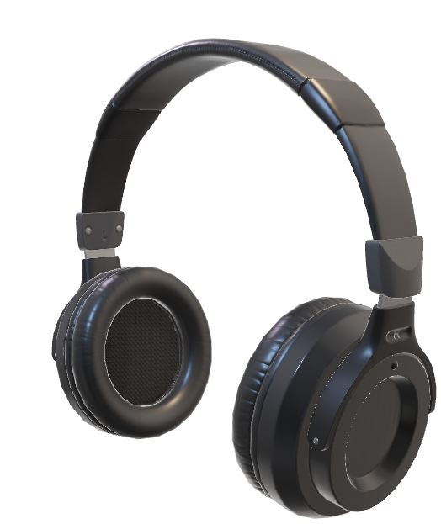

DATA201 GROUP PROJECT
Ezeckiel Mautoatasi
Zheng Chao
Thomas Arnold
Anna McCarthy

Slide 2


DATA201 GROUP PROJECT
Ezeckiel Mautoatasi
Zheng Chao
Thomas Arnold
Anna McCarthy

Slide 3


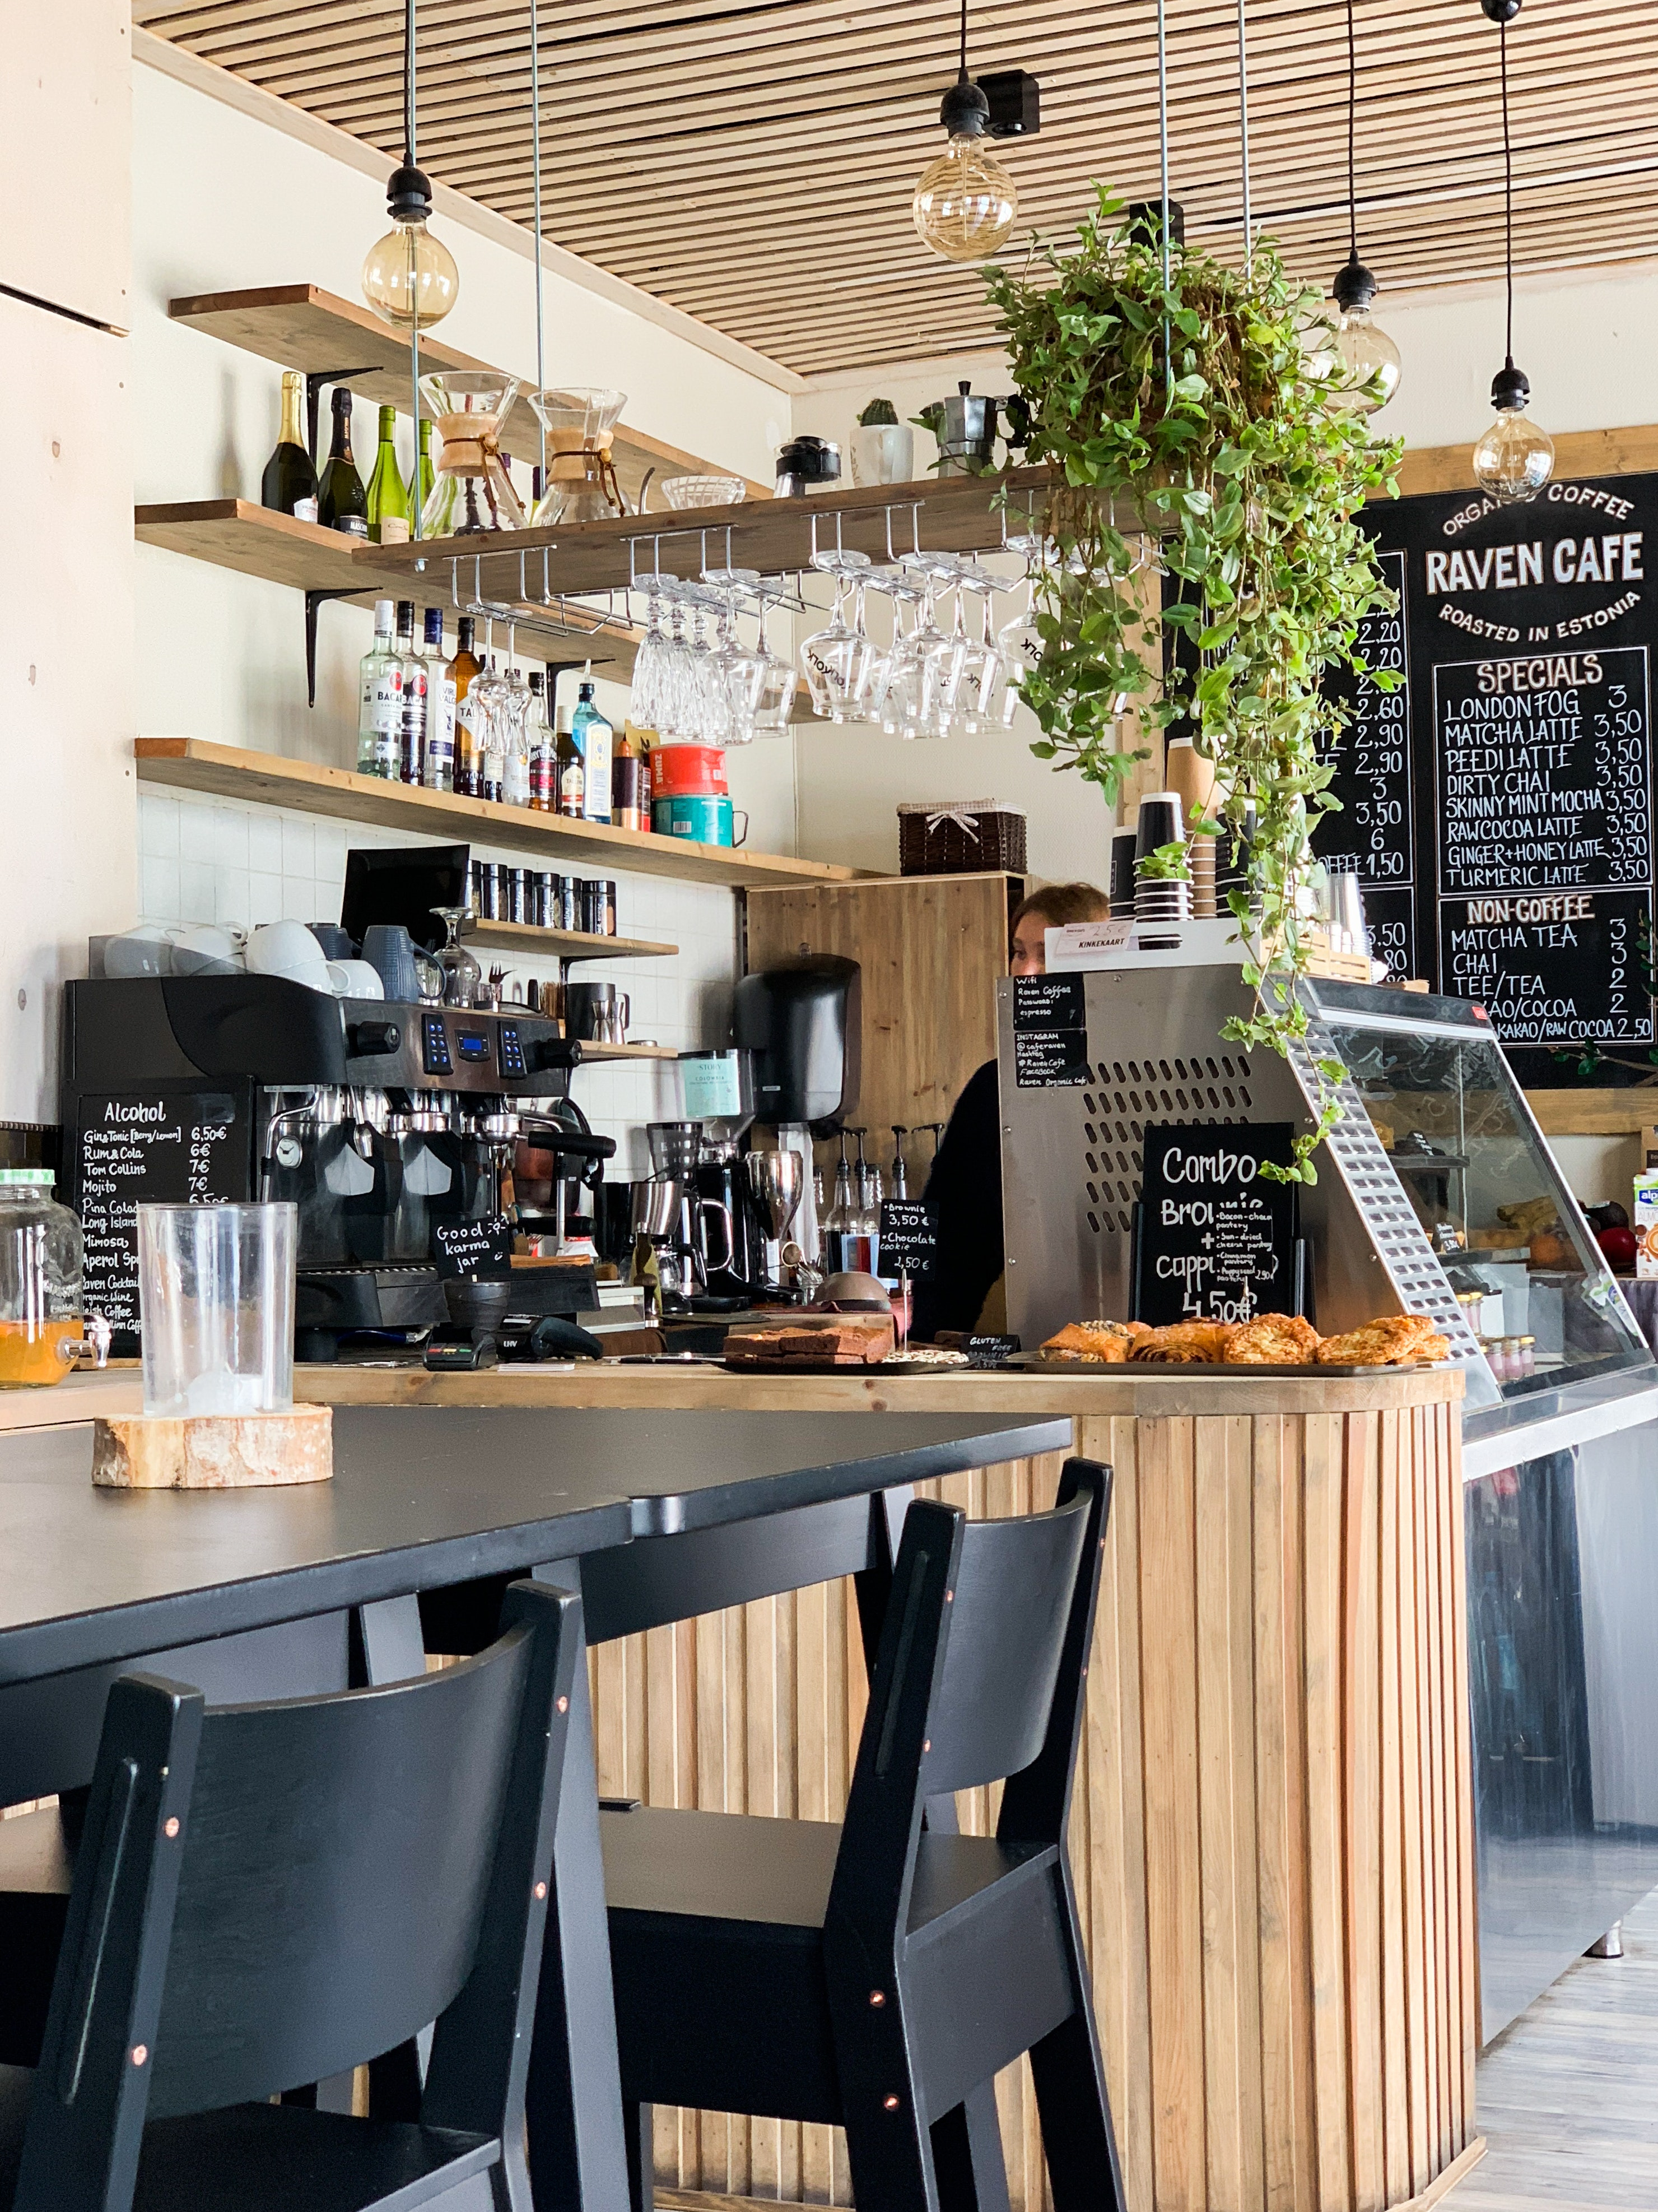
Project
Outline
Target: Christchurch Café’s
Data used:
Christchurch Café Database
NZ-made Music Database
Spotify/YouTube API’s
Goal: Generate personalized playlists of NZ music for local cafes in Christchurch

Slide 4



Project
Management
This project was collaborated on using a GitHub repository
4 Collaborators contributed to the project
24 Commits on 1 Branch
Chose project outline from 5 prototypes

Slide 5



Data
Collection
Dataset 1: Christchurch Cafe Database
Obtained from ‘Neat Places’
A digital pocket guide to New Zealand’s Cafes, Restaurants, Shops and Galleries
Dataset 2: NZ Music Database
Obtained from ‘AudioCulture’
The ‘noisy library of New Zealand music’
Vast library of New Zealand based music, from artists such as Billy T. James or Lorde

Slide 6
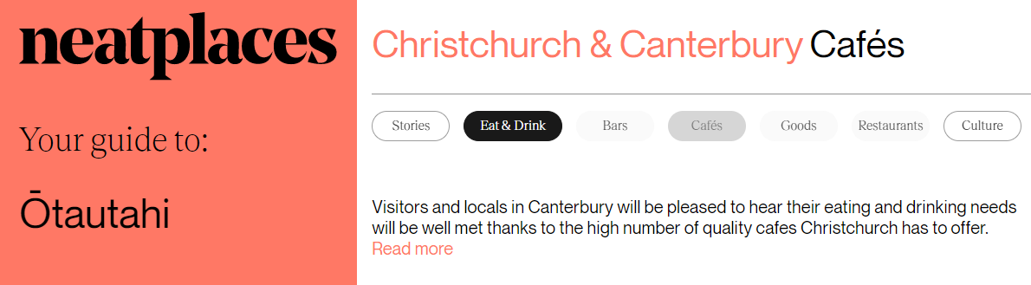

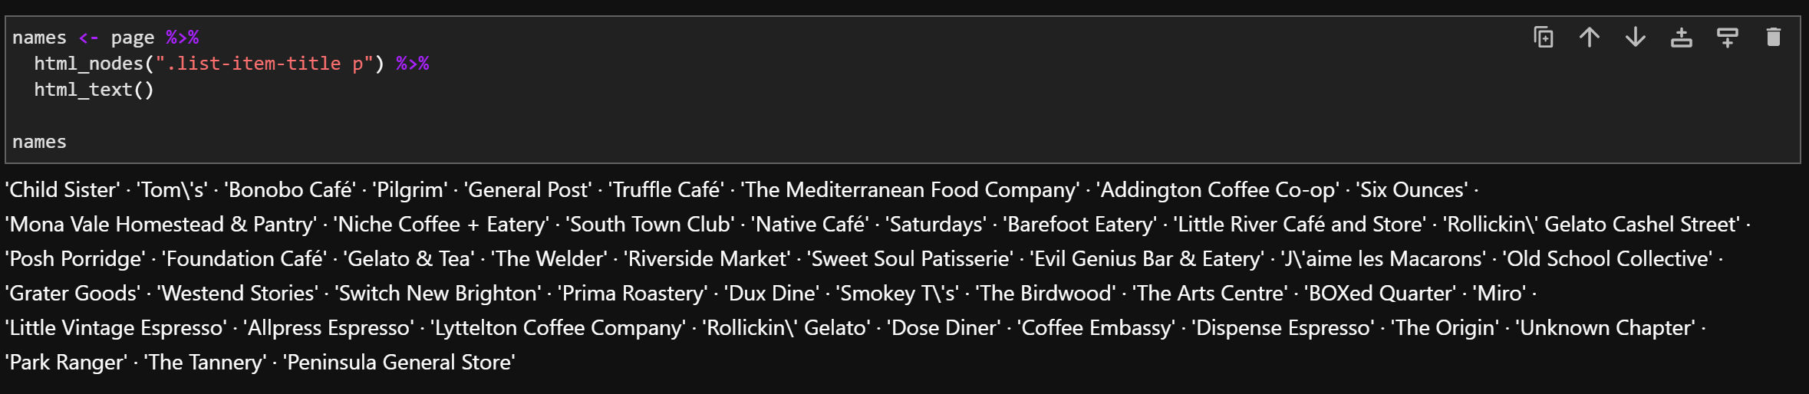
CHRISTCHURCH CAFES DATA

Slide 7
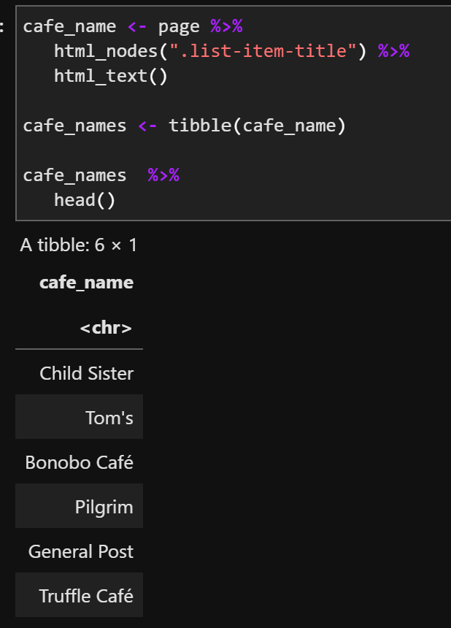
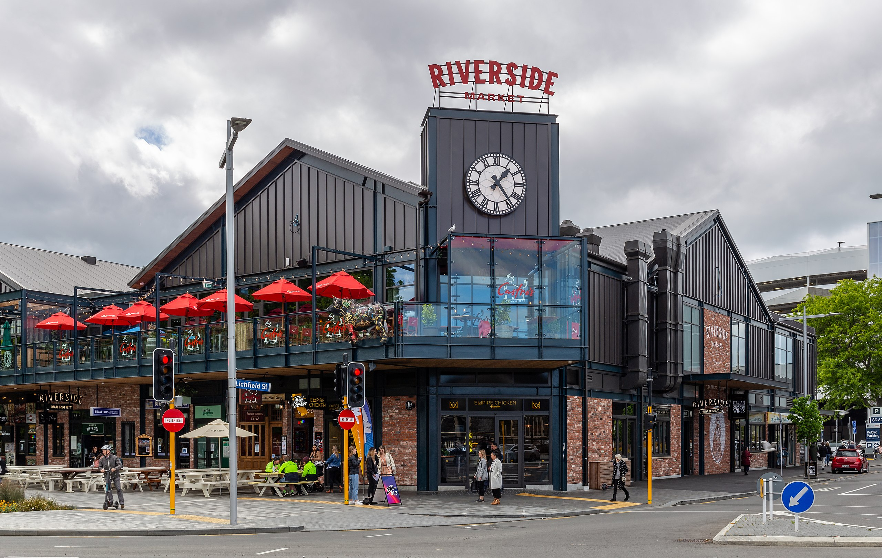
CHRISTCHURCH CAFES
Example Café used:
Riverside Market,
96 Oxford Terrace,
Christchurch Central City, Christchurch 8011

Slide 8
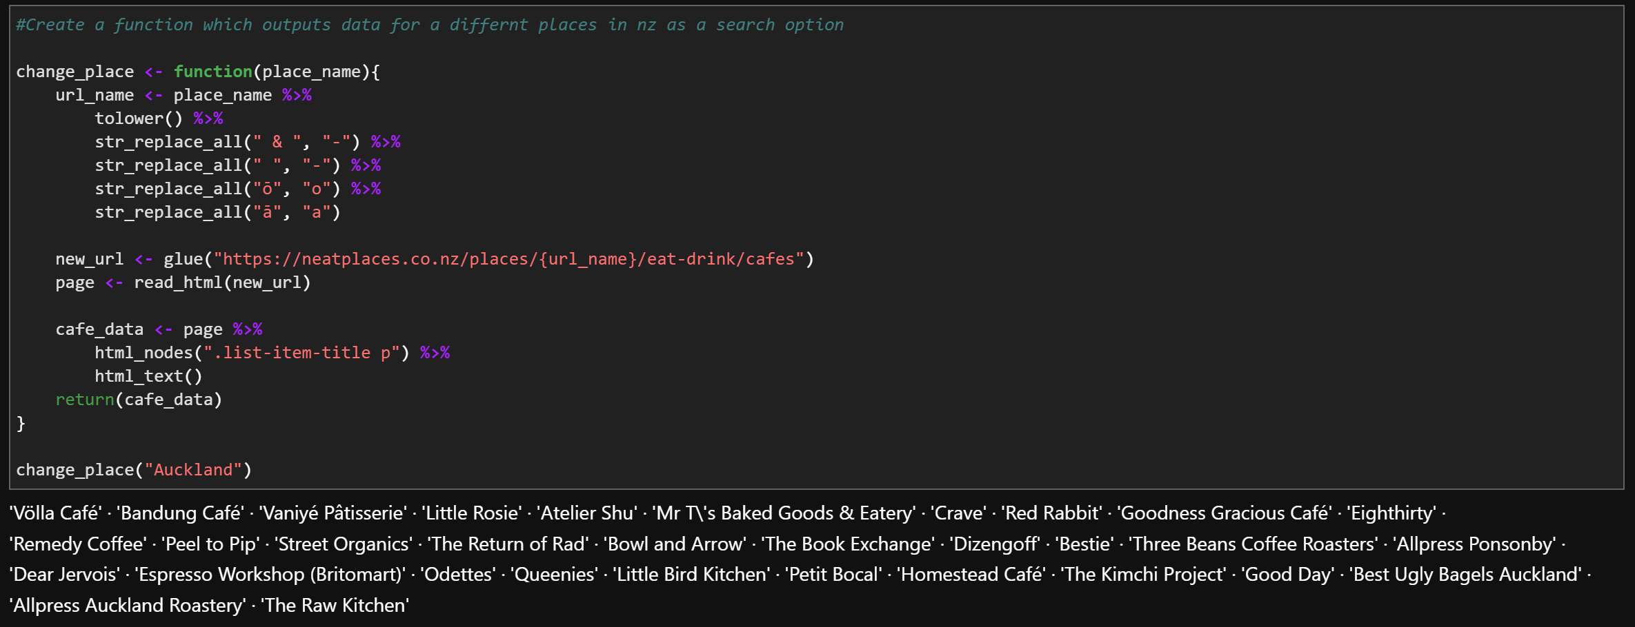
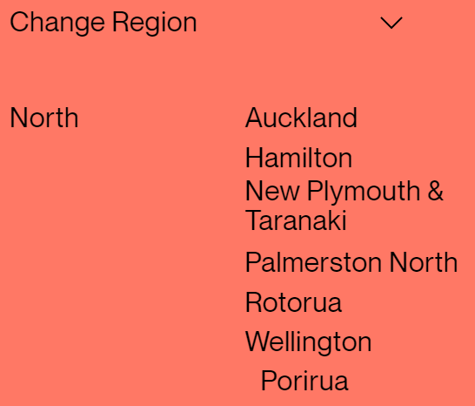
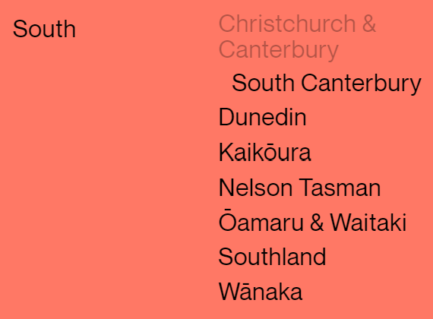
CHRISTCHURCH CAFES CODE

Slide 9
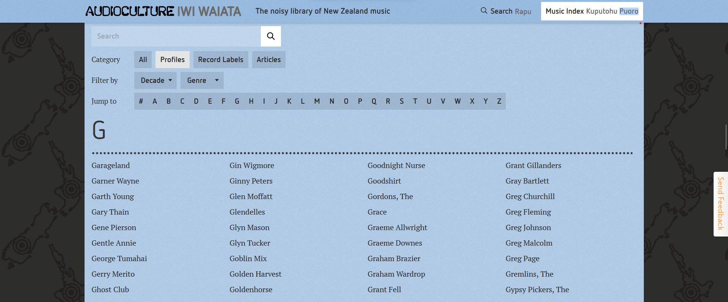

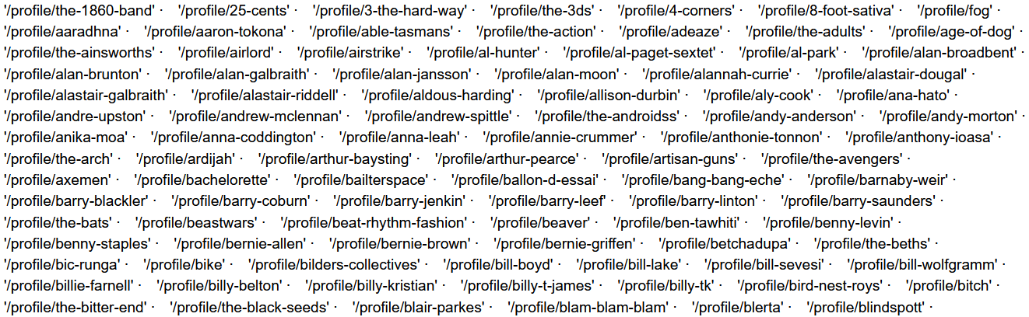
NZ MUSIC DATA

Slide 10
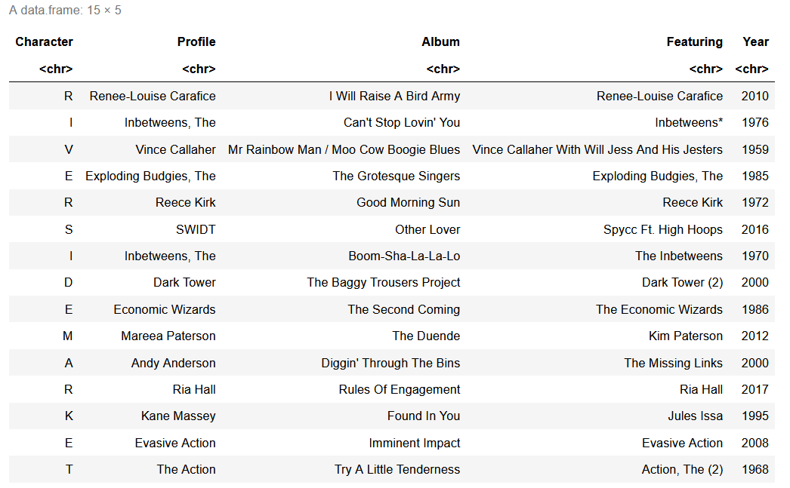
NZ MUSIC
Our code should take a cafés name and return a playlist of NZ artists/bands based on the characters that make up the café's name.
What's needed from the dataset:
NZ profile names
Their discography

Slide 11
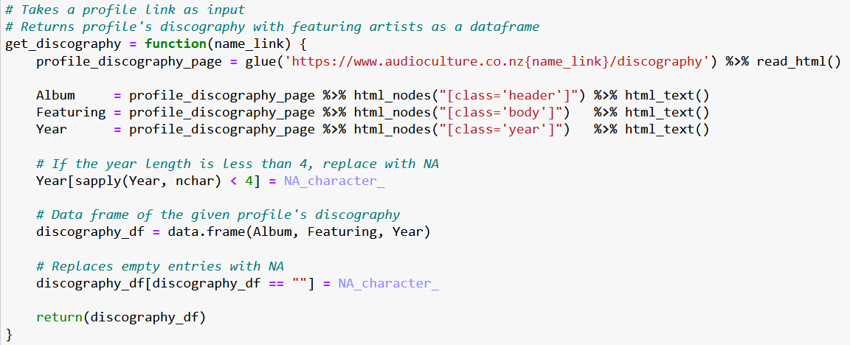
NZ MUSIC CODE

Slide 12
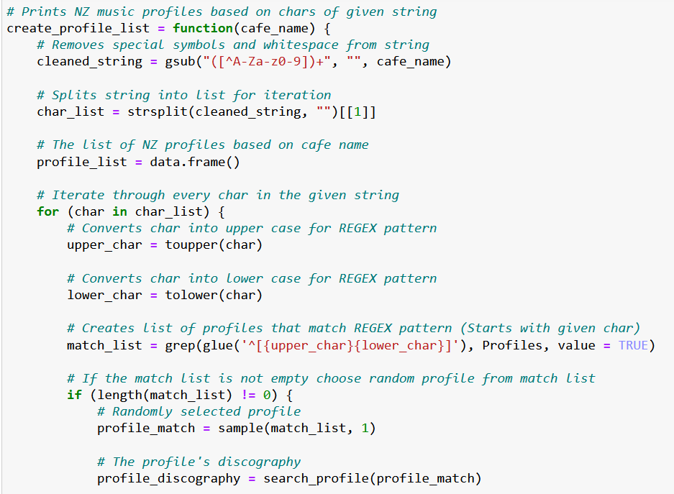
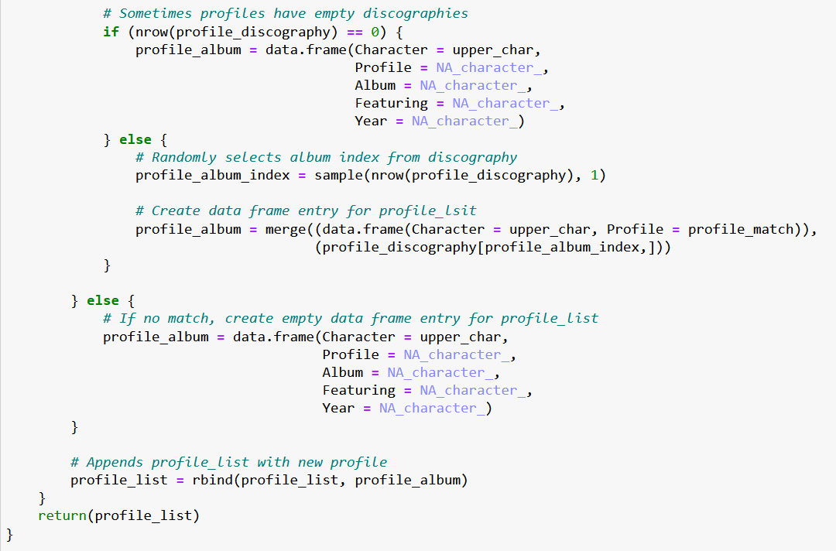
NZ MUSIC CODE

Slide 13






Future
Steps
1. Conversion of outputted song lists into Spotify/YouTube playlists usable by targeted audience
2. Analysis of playlists for fun audio features using Spotify API
Danceability
Speechiness
Acousticness
Valence/Vibe
Energy
Instrumentalness

Slide 14


THANK YOU FOR LISTENING
Any questions?
:)

